Slide 1
SMD Compatible Ku-Band LTCC Circulators
N. Parker¹, C. Kärnfelt², R. Lebourgeois³, L. Roussel⁴, V. Laur¹
¹Université de Bretagne Occidentale, Lab-STICC, UMR CNRS 6285, Brest
²IMT Atlantique, Lab-STICC, UMR CNRS 6285, Brest
³Thales Research & Technology, Palaiseau
⁴Thales Land & Air Systems, Élancourt

Slide 2
Outline
Background & Motivations
Manufacturing Technology
Circulator Design
Manufacturing & Soldering
Measurements
Conclusion

Slide 3
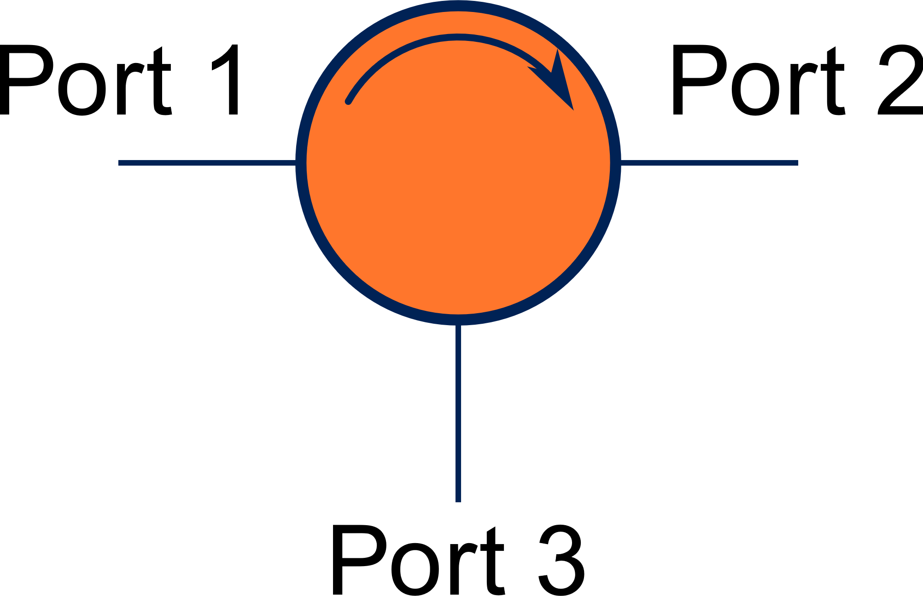
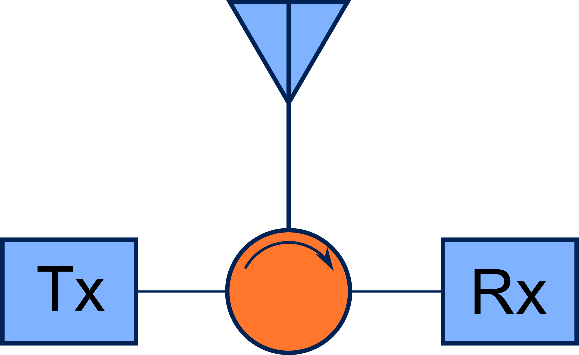
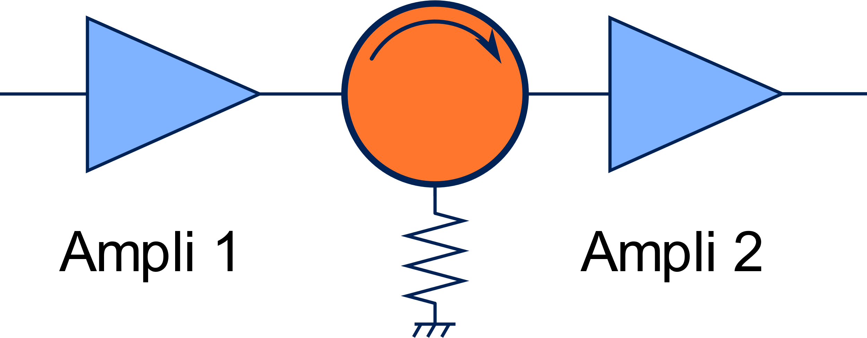
Background & Motivations
Circulator
3-port device
Non-reciprocal
Common uses
Amplification stage decoupling
$$S_{ideal}=\left[\begin{matrix}0 & 0 & 1 \\ 1 & 0 & 0 \\ 0 & 1 & 0\end{matrix}\right]$$
Full duplex system

Slide 4
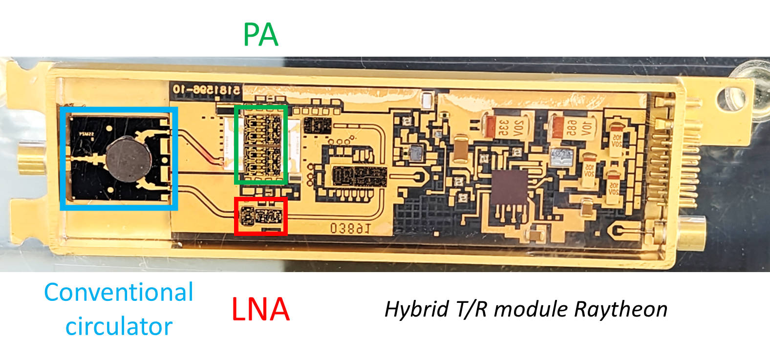
Background & Motivations
Switch from mechanically steered antenna to AESA
⇒ Requires a great number of Tx/Rx modules
Circulator drawbacks
Expensive
Bulky
Hard to integrate

Slide 5
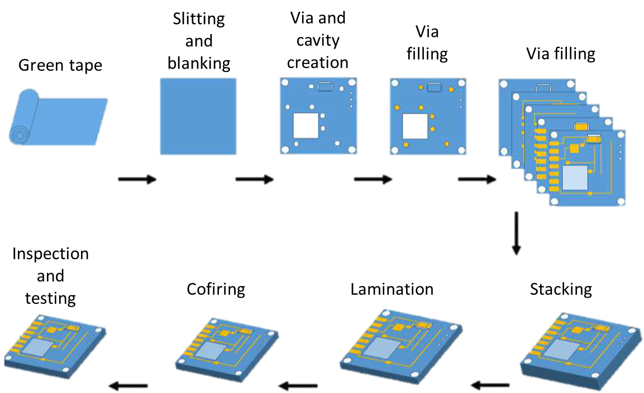
Manufacturing Technology
LTCC Technology ?
Low Temperature Cofired Ceramics (< 950 °C)
High flexibility
2.5D Technology
Multi-materials
Easy to industrialize
Few ferrites available

Slide 6
Manufacturing Technology
Development of new ferrite materials
Garnet ferrite
Moderate magnetization of 1900 G
High relative permittivity of 21
Spinel ferrite
Increased magnetization of 3800 G
Moderate relative permittivity of 13

Slide 7
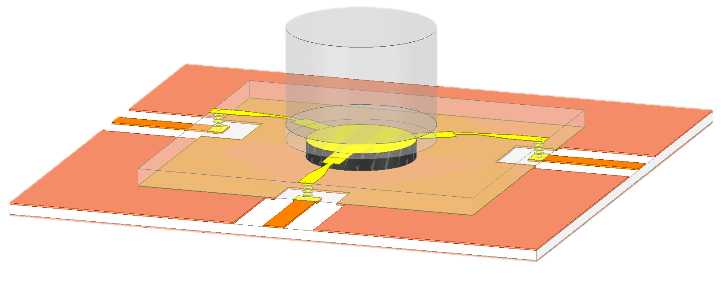
Circulator Design
LTCC Technology manufacturing
SMD compatible
7×7×0,352 mm
Ø3×2 mm magnet

Slide 8
Circulator Design – Methodology & Materials
Design steps
Y-Junction circulator sizing
SMD transition design
Complete SMD circulator simulation
Nom | ε_{r} | tan δ | 4πMs (G) | ΔH (Oe)
Garnet | 21 | 3.10⁻³ | 1900 | 100 @ 10 GHz
Spinel | 13 | 1.10⁻³ | 3800 | 100 @ 10 GHz
VLF220Aq4 | 21 | 3.10⁻³ | - | -
Teflon™ | 2,1 | 1.10⁻³ | - | -
Materials properties
Nom | Br (KG) | Hcb (KOe)
Magsy YXG-28 | 10,3 - 10,8 | 9,5 - 10,2
Magnet properties

Slide 9
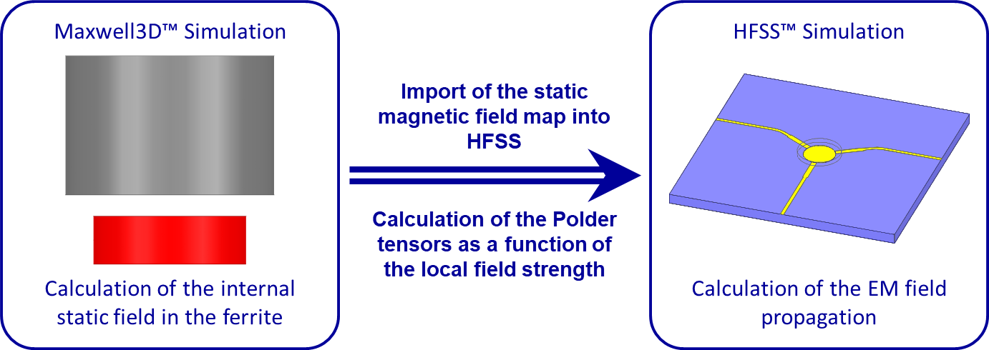
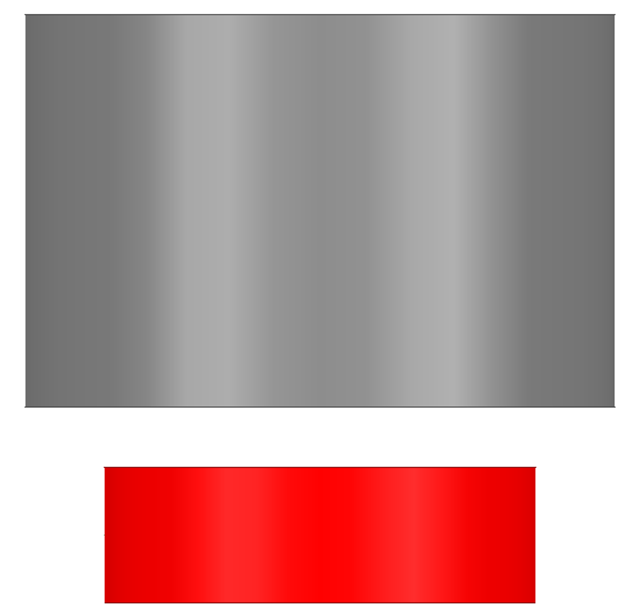
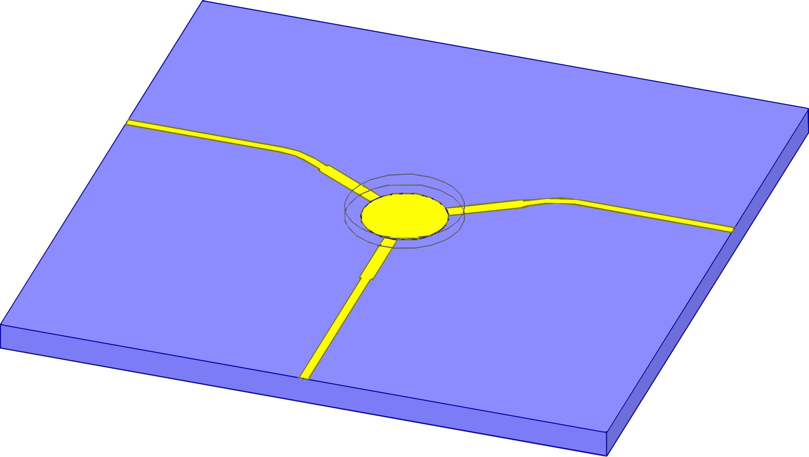
Circulator Design – Simulation setup
EM Ansys HFSS™ linked to the Magnetostatic solver Ansys Maxwell3D™
Internal magnetic field inhomogeneity is taken into account in the HFSS simulation
Maxwell3D™ Simulation
Calculation of the internal static field in the ferrite
HFSS™ Simulation
Calculation of the EM field propagation
Import of the static magnetic field map into HFSS
Calculation of the Polder tensors as a function of the local field strength

Slide 10
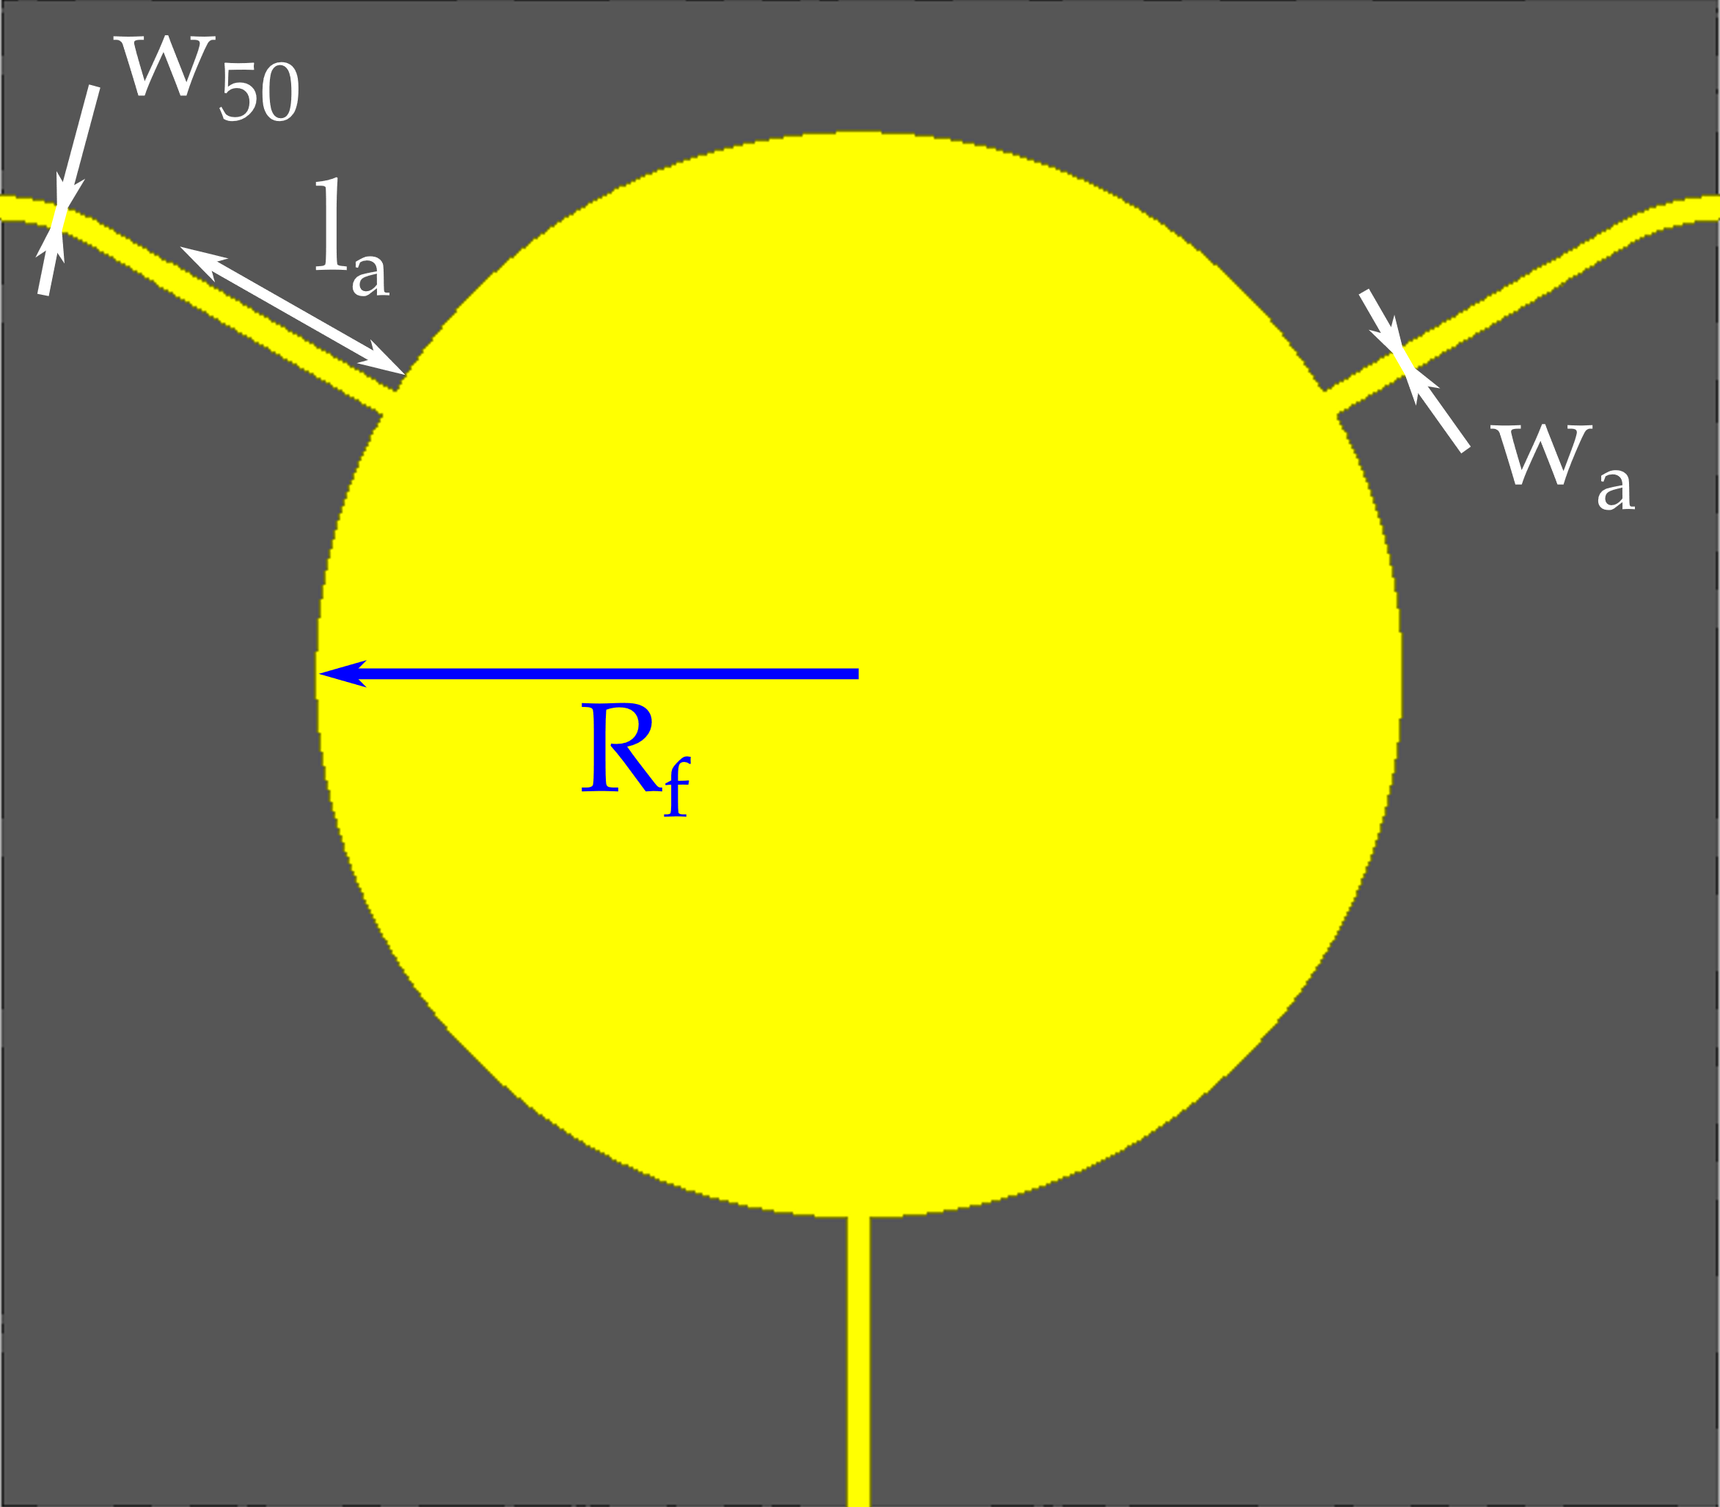
Circulator Design – Y-junction Circulator sizing
Initial sizing done using Bosma’s model
Optimization of the dimensions using HFSS™
$$R=\frac{1,84}{2π\sqrt{μ_{eff}ε_{r}}}λ$$
Design | R_{f} (µm) | l_{a} (µm) | w_{a} (µm) | w₅₀ (µm)
Garnet design | 1100 | 820 | 287 | 115
Spinel design | 1100 | 780 | 407 | 115

Slide 11
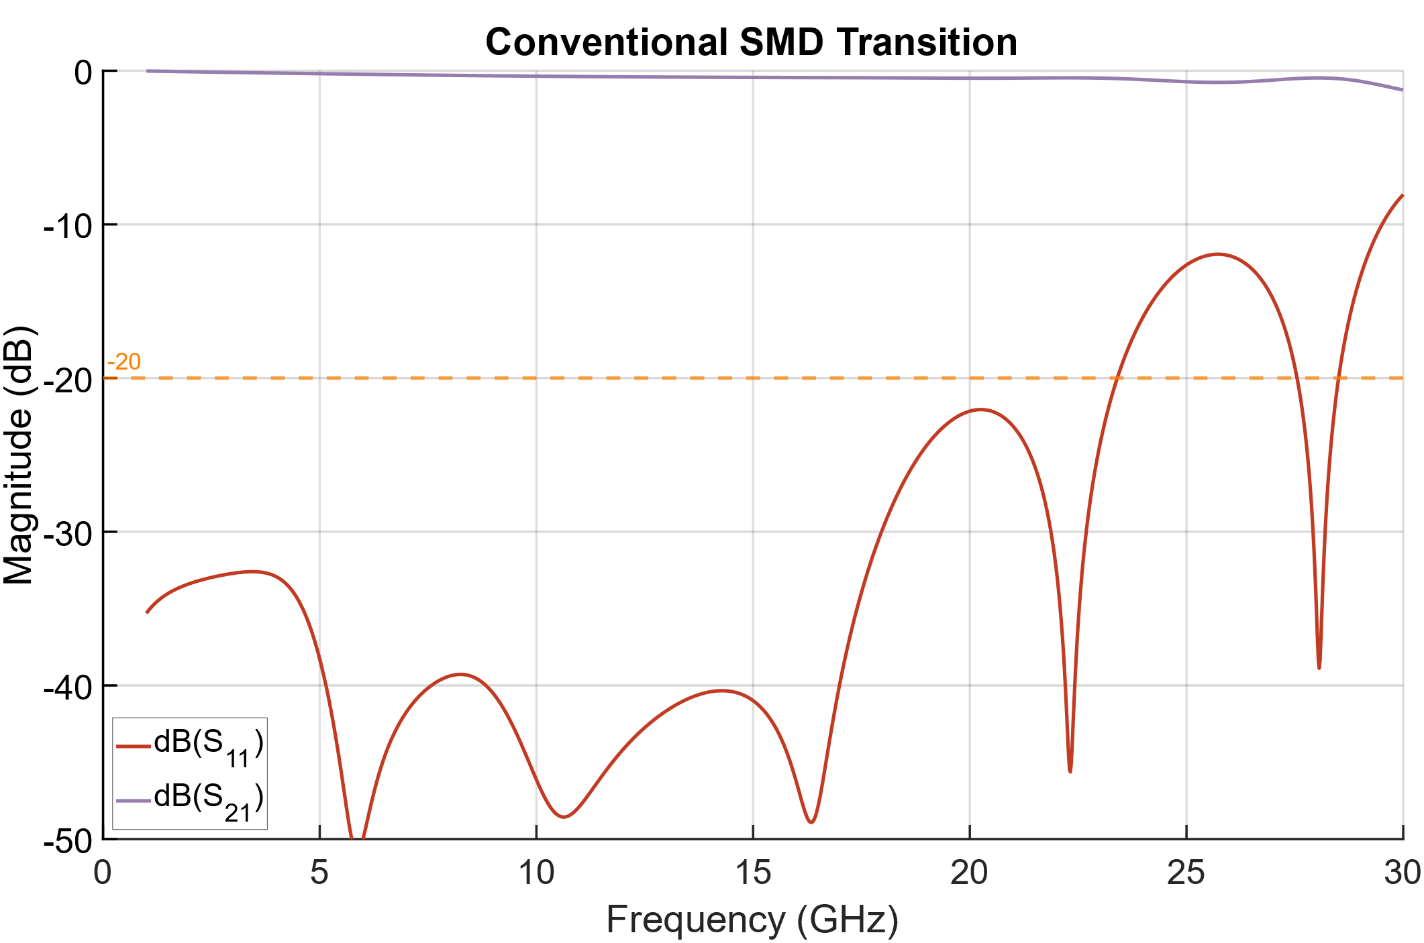
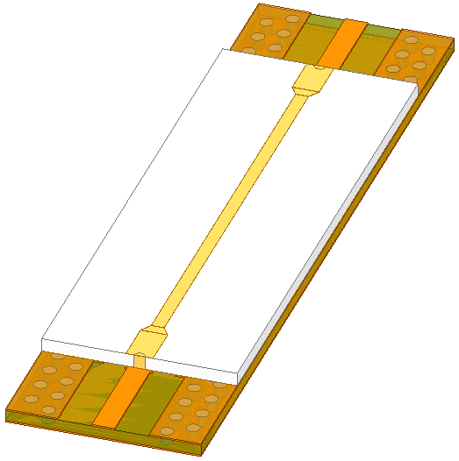
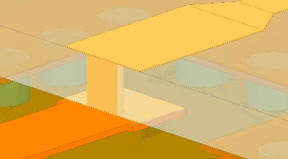
Circulator Design – SMD transition design
Conventional SMD transition

Slide 12
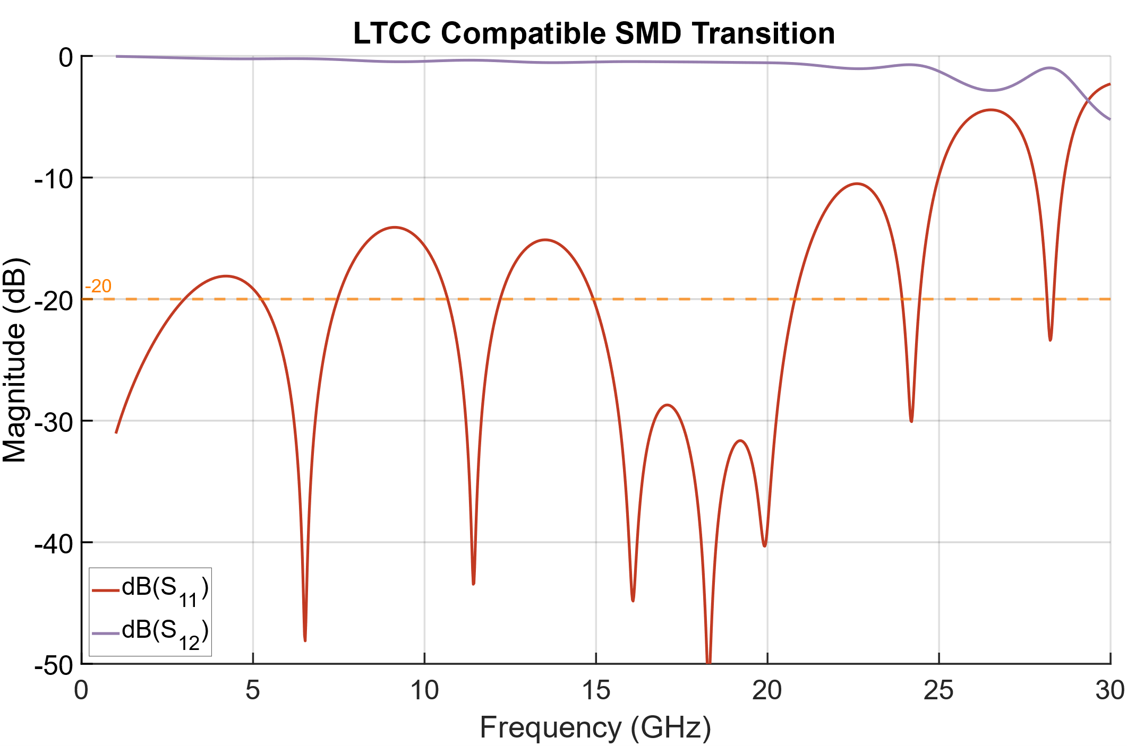
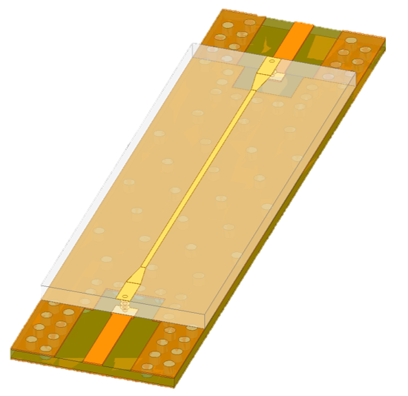
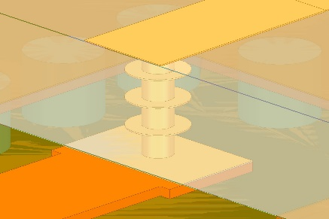
Circulator Design – SMD transition design
SMD transition modified for LTCC

Slide 13
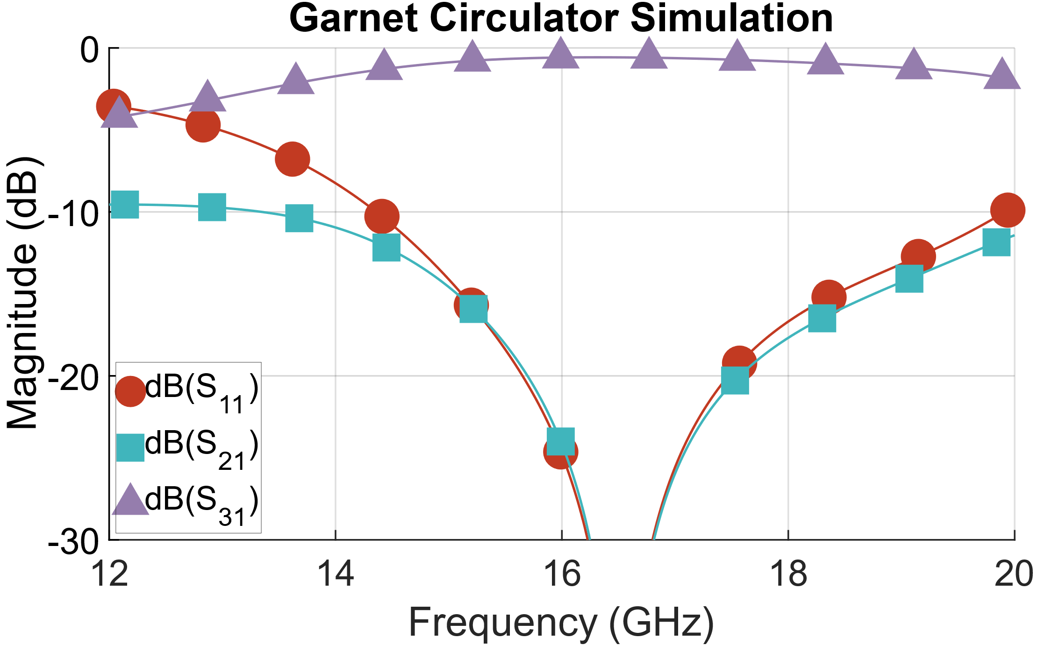
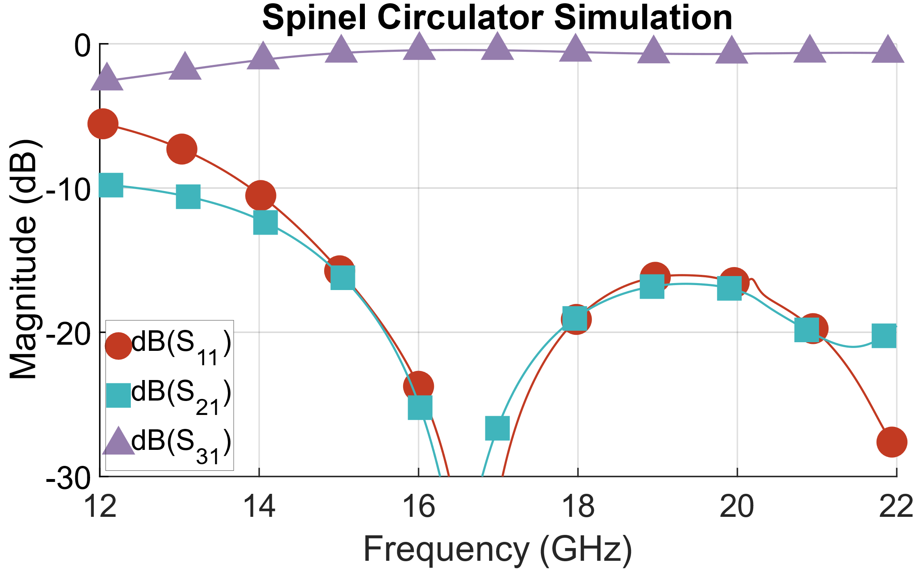
Circulator Design – Complete SMD circulator
Garnet circulator
Spinel circulator
-0.51dB @16.22GHz
-0.47dB @16.29GHz
13.5%
18.7%

Slide 14
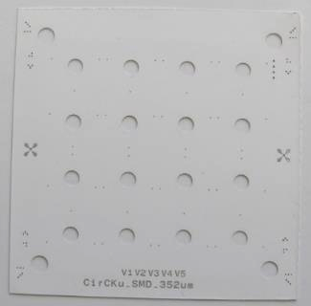
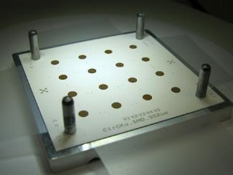
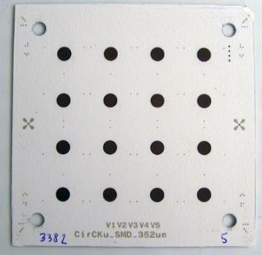
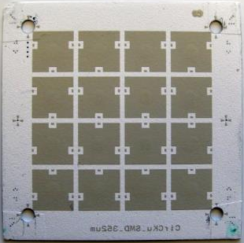
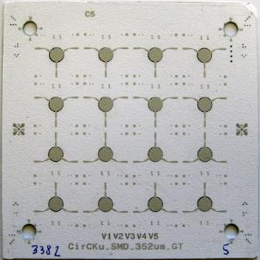
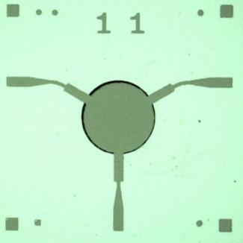
Manufacturing
Multi-circulator matrix manufacturing
Tape cutting
Multi-layer stack
Stacking
Backside screen printing
Topside screen printing
Circulator view before firing

Slide 15
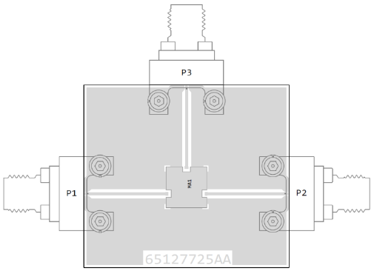
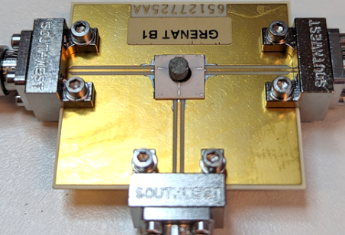
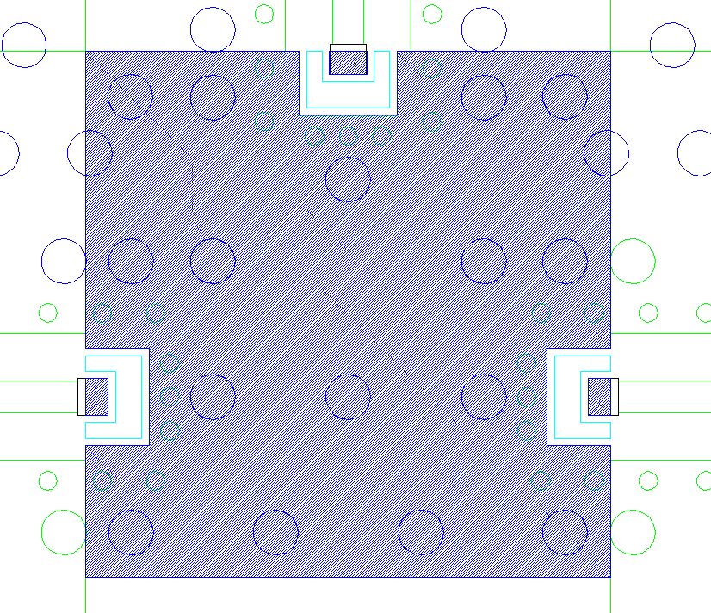
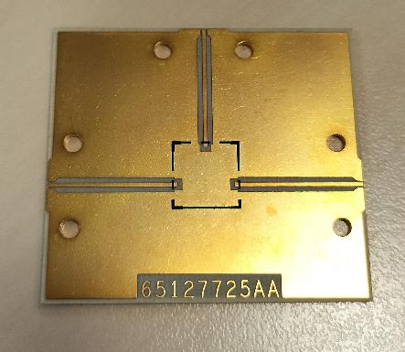
Soldering
Soldering on a Rogers substrate stack
X-Ray observation of the soldering
PCB Design
Soldered circulator on the connectorized PCB
Manufactured PCB

Slide 16
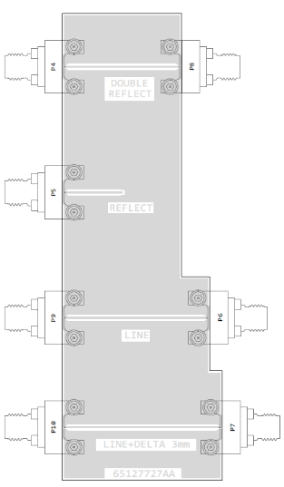
Measurements – Setup
3-port measurements
Southwest connectors
Custom TRL calibration kit

Slide 17
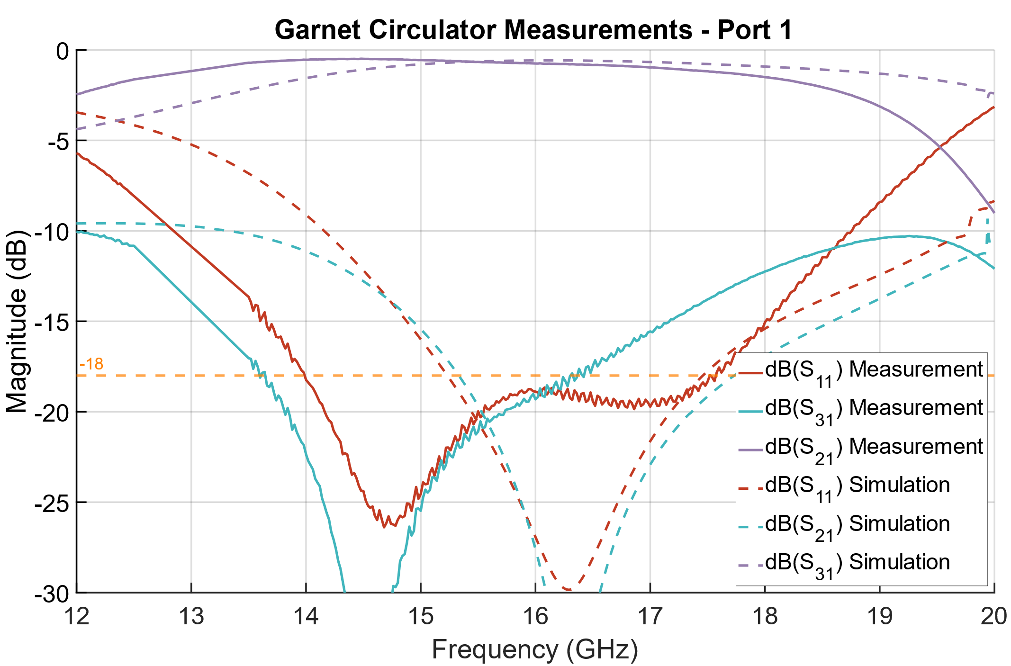
Measurements – Garnet circulator
-0.48dB @14.48GHz
15.3%
Notes:
Pertes max à -18 dB 0.8db

Slide 18
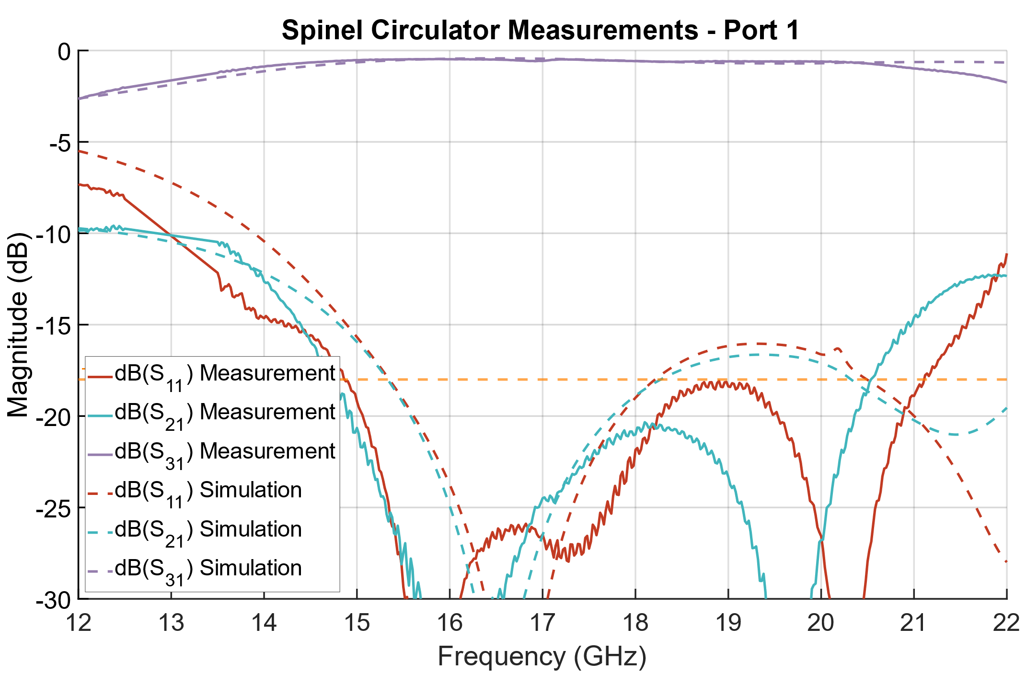
Measurements – Spinel circulator
-0.47dB @15.88GHz
32%
Notes:
Pertes max à -18 dB 0.73db

Slide 19
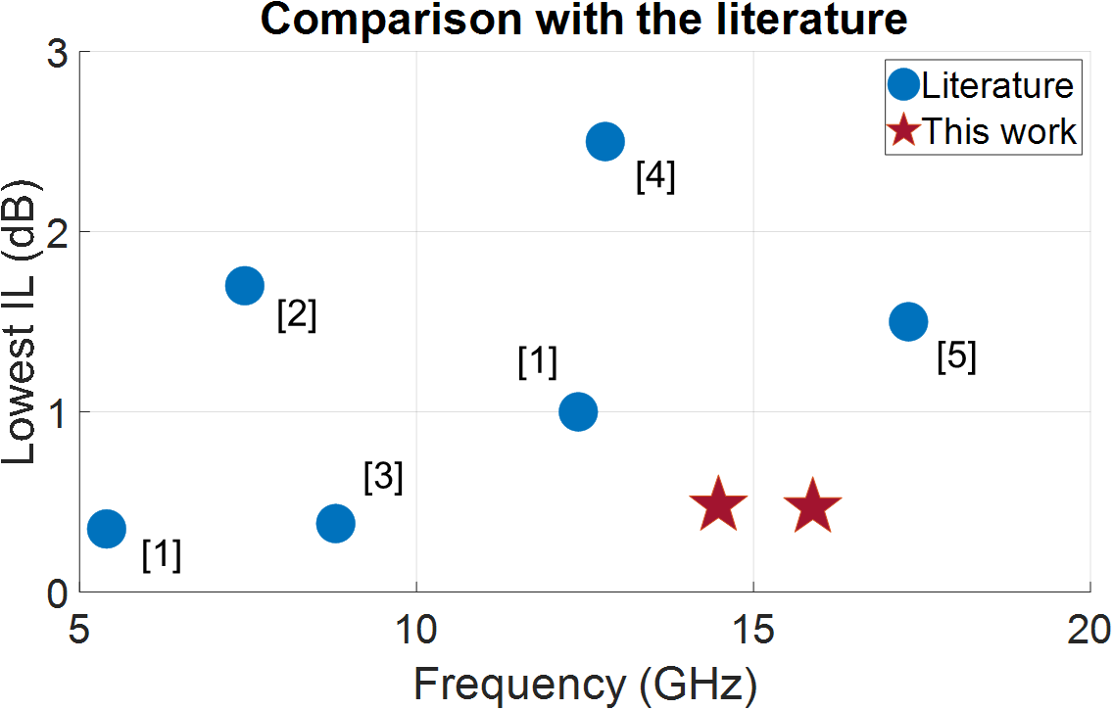
Conclusion
Both circulator achieved good performances
Validation of the SMD capabilities through successful soldering
Spinel ferrite more promising

Slide 20
Références
[1] R. van Dijk, G. van der Bent, M. Ashari and M. McKay, "Circulator integrated in low temperature co-fired ceramics technology," 2014 44th European Microwave Conference, 2014, pp. 1544-1547, doi: 10.1109/EuMC.2014.6986744.
[2] Jensen, T., Krozer, V., & Kjærgaard, C. (2011). Realisation of microstrip junction circulator using LTCC technology. Electronics Letters, 47(2), 111. doi:10.1049/el.2010.2419
[3] L. Qassym, V. Laur, R. Lebourgcois and P. Queffelec, "Ferrimagnetic garnets for Low Temperature Co-fired Ceramics microwave circulators," 2018 IEEE/MTT-S International Microwave Symposium - IMS, 2018, pp. 750-752, doi: 10.1109/MWSYM.2018.8439250.
[4] P. R. Raj, A. Basu and S. K. Koul, "Comparison of triangular geometries of Y-junction in co-sintered LTCC based microstrip circulator," 2017 IEEE MTT-S International Microwave Workshop Series on Advanced Materials and Processes for RF and THz Applications (IMWS-AMP), 2017, pp. 1-3, doi: 10.1109/IMWS-AMP.2017.8247361.
[5] S. Yang, W. Shi, H. Bai and T. Zhang, "Circulator Integrated in LTCC with Screen Printed Co-Firing Ferrite for Space Application," 2018 International Conference on Microwave and Millimeter Wave Technology (ICMMT), 2018, pp. 1-3, doi: 10.1109/ICMMT.2018.8563702.

Slide 21
Thank you for your attention! What are your questions?

